Slide 1
Extraordinary teachers, exceptional students:
An interplay
Dr Yariv Doron
Child and Adolescent Psychiatrist

Slide 2

What will we talk about ?
Understand giftedness in more than one way
Why is it important ?
Please pay attention to elements which you can impliment in your classroom. The idea of today is to help you think somewhat differently.
When you see an icon like this use it to have a think is there is something here you can implement.

Slide 3
Giftedness matters

Slide 4
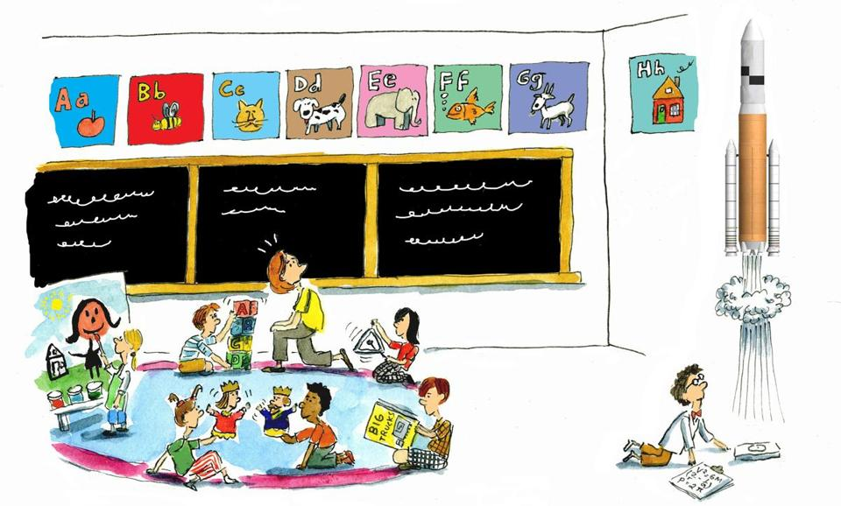

Slide 5

Why do we teach gifted differently?
In 1957, Sputnik took the world by storm.
At that time, the Ford Foundation was promoting projects of talented students which will have early entrance to University.

Slide 6
Why do we teach gifted differently?
“There are those who argue that it is psychologically unsound and politically undemocratic for one child to proceed faster or to have a richer academic diet than another.... But what is too often ignored is the greatest risk of all—the risk of adhering stubbornly to a clearly imperfect set of practices which are frustrating the development of young talent at a time in history when this nation urgently needs to develop its human resources to the full.”

Slide 7
Why do we teach gifted differently?
The resulting attention and resources to talented youths led to the National Defence Education Act
It also led to a boom of innovation and scientific productivity in the U.S.
To date, only four states currently fully fund their mandates to identify and serve gifted students. Many such students spend their days in school unchallenged— relearning material they have already mastered.

Slide 8

Local pride
A 2010 report showed that New Zealand, Canada and Australia have nurtured at least twice the proportion of mathematically advanced students that the U.S. has.
It is our duty to carry on training teachers and educators to identify and promote the gifted students.

Slide 9
What is giftedness ?

Slide 10
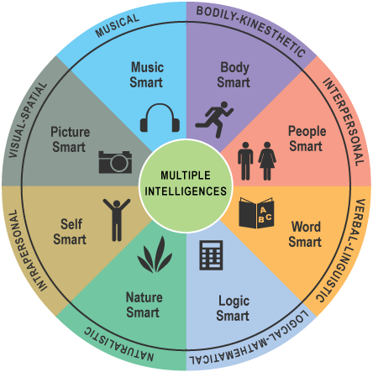
Gardner’s Multiple Intelligences

Slide 11
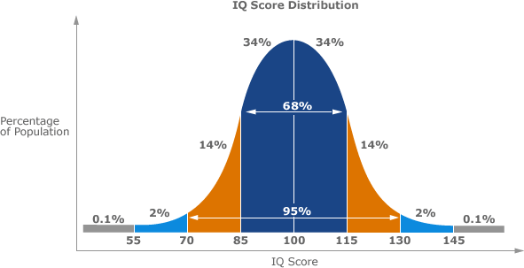
Giftedness definition
Giftedness implies an ability to perform at the extreme upper end of the distribution in a certain area.
There’s a catch.. It’s only a potential..

Slide 12
Giftedness definition
Initially Giftedness will be largely defined by potential (IQ for example), followed by demonstrated achievement and, later, by eminence.
Personally .. I find the word “Exceptional” to be the easiest to use, as it encompass the achievement.
In recent years educators have begun to look beyond IQ tests to measure giftedness.

Slide 13
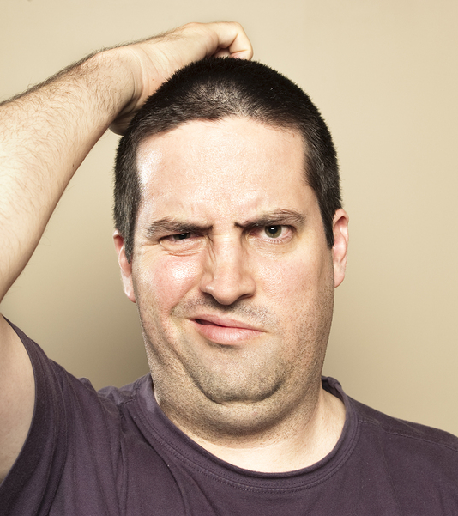
Here’s a question for you
What is the difference between a REALLY smart kid and a gifted one ?

Slide 14
Giftedness definition
Torrance Tests of Creative Thinking –
  https://99u.adobe.com/articles/7160/test-your-creativity-5-classic-creative-challenges
  http://www.ststesting.com/ngifted.html
A good attempt to replace IQ testing by Creativity and fluency testing, which seems better predictor than IQ.
Was found to be three times better than IQ tests at predicting the quantity and quality of publicly recognized creative accomplishments in adulthood

Slide 15
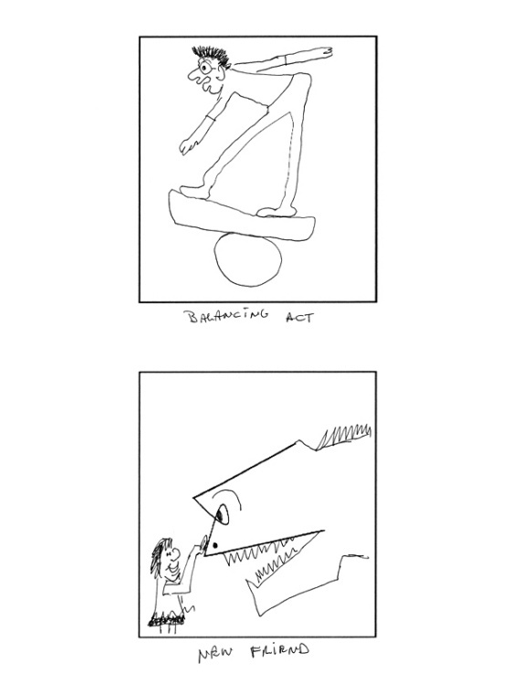


Slide 16

Giftedness definition
Another type of question: How many Alternative Uses for Paperclips can you come up with ?
Hold papers together
Cufflinks
Earrings
Imitation mini-trombone
Thing you use to push that emergency restart button on your router
Keeping headphones from getting tangled up
Bookmark

Slide 17
Giftedness definition
Overall, the test measures divergent thinking across four sub-categories:
Fluency – how many uses you can come up with
Originality – how uncommon those uses are (e.g. “router restarter” is more uncommon than “holding papers together”)
Flexibility – how many areas your answers cover (e.g. cufflinks and earrings are both accessories, aka one area)
Elaboration – level of detail in responses; “keeping headphones from getting tangled up” would be worth more than “bookmark”

Slide 18

So here’s an idea !
Why not start in your first week of the year, with a collection of questions and puzzles from the Torrance test ?
It is a fun activity, will get the class to know each other, and will help you as a teacher to “sniff out” those who are potentially exceptional.

Slide 19
Some Characteristics of Gifted Students
Advanced vocabulary
Curious
Great memory
Catches on quickly
Sees connections ☺
Sense of humor
Sense of justice ☹
Higher levels of thinking
Notices cause and effect
Intense
“Passionate” interest(s)
Bossy?
Likes to work alone?
Prefers adult company?
Notes:
May have talked early
Very retentive memory; memorize quickly
Lose interest when asked to do “more of the same”
Or odd sense of humor
Can concentrate for long periods on subjects of interest
Has a wide knowledge and interest in the world
Has strong opinions
No one will show all of these behaviors, but very bright children will fit a significant number of them.
Keep in mind that gifted students are not a homogeneous group with needs that can be satisfied through a single administrative adjustment. We support a variety of educational options.

Slide 20
Giftedness definition
Giftedness has long been associated with high levels of intrinsic motivation—that is, engaging in a task for the sake of learning
2008 study psychologist Timothy W. Curby, then at the University of Virginia: “…one of the major predictors of giftedness amongst kindergarten student was the ability to do and complete work even in an environment in which teachers may not be directly supervising the work.

Slide 21



A quick recap
Opportunity
Provide intellectual enrichment to all students, to ferret out the hidden talents
Potential
It matters. It is malleable, however, and needs to be cultivated
Psychological Strength
Persistence, Motivation, Social skills and risk taking as determinants in successful development of talent

Slide 22
Doing

Slide 23
Providing opportunities
In a 2010 a study assessed participation in various educational opportunities such as academic competitions, research apprenticeships, academic clubs, and accelerated classes among 1,467 individuals who had been identified as talented in math at age 13.

Slide 24
Providing opportunities
Those who had been involved in more of these activities and classes had, at age 33, a higher rate of notable accomplishments in science, technology or math, such as earning a Ph.D., obtaining patents or securing tenure.
(2010, Jonathan Wai of Duke University and colleagues )

Slide 25
Providing opportunities
Summer programs, for example, may feature a range of topics that are not typically available in the regular classroom, such as human anatomy for fourth graders and robotics for middle schoolers.
This is an easy way to supplement the curriculum, without interfering too much in a teacher’s daily work.

Slide 26
Doing
Persistence and Reassurance
  Providing opportunities is not enough, however. Talented individuals must take advantage of them.
  Research shows that young people may shy away from educational or extracurricular offerings for various reasons, including fear of competition and failure, poor study and organizational skills, and shyness.
  Persistence and reassurance, focus and drive, are also essential to the ability to undergo the intense practice and preparation necessary to reach the top.

Slide 27
Cultivating Genius

Slide 28

Research has shown that it takes about 10,000 hours of guided study or practice to reach levels of expertise in most domains.

Slide 29
Having said that – for some gifted persons – the average time to reach this expert point might be accelerated and shortened.

Slide 30
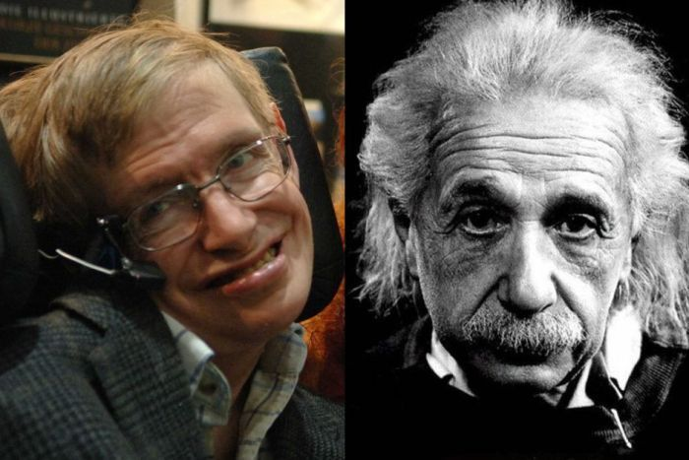
These two learned lots of physics before they commenced their creative career.

Slide 31
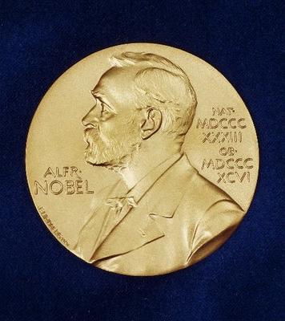
Cultivating Genius
Gifted people are more likely to exhibit unusually wide interests and hobbies and to display exceptional versatility, often contributing to more than one domain of expertise.
One research found that Nobel laureates in science are more involved in the arts than less eminent scientists.

Slide 32
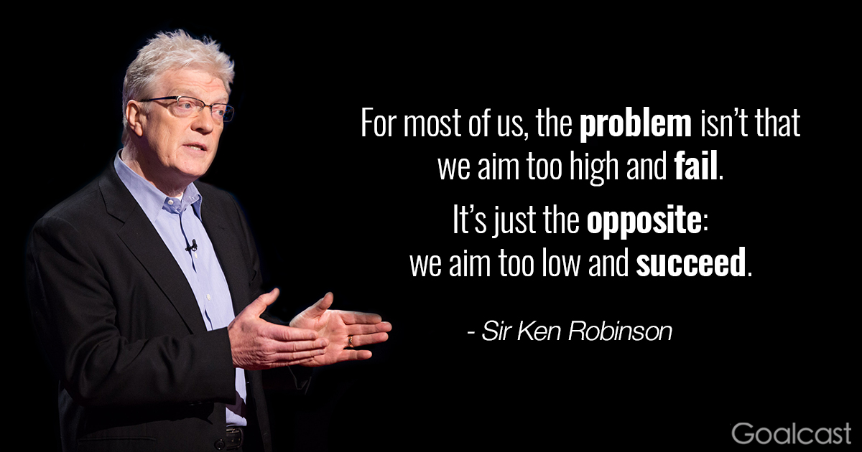
TED talk
Sir Ken Robinson: How to escape education’s Death Valley ?
https://www.ted.com/talks/ken_robinson_how_to_escape_education_s_death_valley#t-3663

Slide 33
Cultivating Genius
When it comes to cultivating genius, talent matters, but motivation may matter more.
Psychologists have identified three critical elements that support motivation, all of which you can tweak to your benefit:
Autonomy
Competence
Value

Slide 34
Cultivating Genius
You gain motivation
when you feel in charge
Competence
Autonomy
Practice makes students consider themselves more, while a sense of competence strongly predicted their engagement
Value
Motivation blossoms when you
stay true to your beliefs and values

Slide 35
Cultivating Genius
Autonomy
Psychologists Edward L. Deci and Richard M. Ryan of the University of Rochester evaluated students, athletes and employees. The researchers have found that the perception of autonomy predicts the Energy with which individuals pursue a goal.
Competence
Carol S. Dweck, a psychologist at Stanford University, has shown that competence comes from recognizing the basis of accomplishment. Believing that effort fosters excellence can inspire you to keep learning. It is more powerful than believing in your talent.
Value
Research found strong positive correlation between valuing a subject in school and a student’s willingness to investigate a question independently. And for the Process itself – it was found that reflecting on why an activity is meaningful could make you more invested in it.

Slide 36
Cultivating genius
The next time a student struggles to follow a task or park himself at the piano bench, ask yourself what is missing. Often the answer lies in one of these three areas: feeling forced, finding an activity pointless or doubting your capabilities.
Autonomy
Competence
Value

Slide 37

Gender

Slide 38

Try this simple exercise:
Name 10 female geniuses from any period in history.
Odds are you ran out of names pretty quickly.

Slide 39
Gender
Dorothy Hodgkin
won the Nobel Prize in 1963 for pioneering protein crystallography
Barbara McClintock discovered gene activation
Aphra Behn
One of the first female writers to break the gender barrier and actually publish professionally
Virginia Woolf
A Modernist writer
Frida Kahlo
controversial and thought provoking both in her art and in her personal life.
Maryam Mirzakhani:
an Iranian mathematician who serves as a professor of mathematics at Stanford University
Laura Deming
a world renowned researcher at the field of longevity and genetics
Rear Admiral Dr. Grace Murray Hopper
the most accomplished women in computer science

Slide 40

IQ tests in large communities are repeatedly showing that
the 3 highest IQ scores always belong to females.

Slide 41
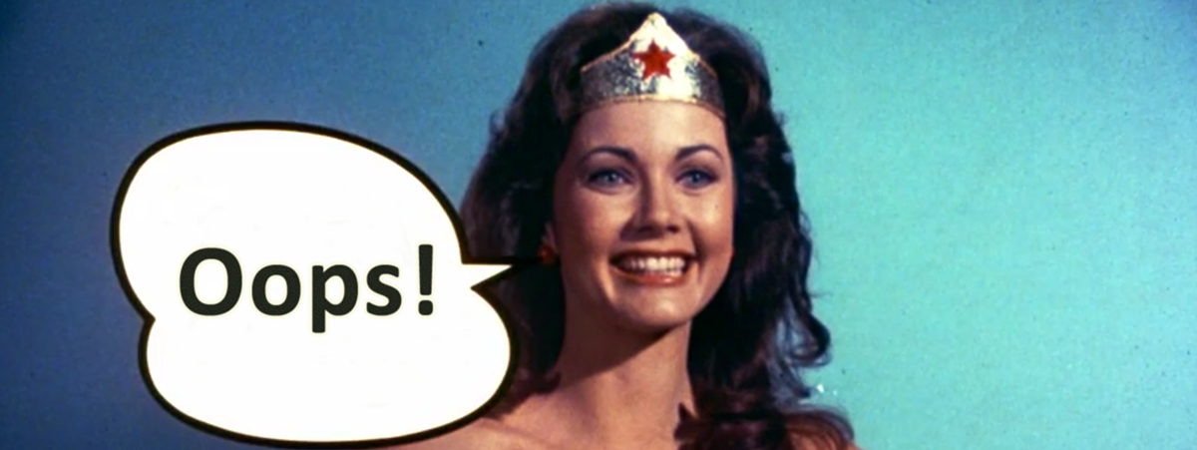
But !! Baer and Kauffman found a LARGE GAP in the productivity of creative men and women
The data suggest that early in their careers, women are pulling out of the race to eminence.

Slide 42
gender
The absence of women reveals the unequivocal role of culture and opportunity in the flourishing of brilliance.
In the developed world today women’s access to education and resources is essentially on a par with that of men.
But there are huge structural differences in how men and women live out their lives .

Slide 43
gender
Gifted women face a choice: they can pursue their interests wholeheartedly, or, in line with cultural imperatives, they can split their time and serve as the anchors of their families.
Newer statistics are actually reassuring:
  More women now graduate from college and enter medical school than men,
  More female athletes qualified for U.S. Olympic teams this year than men.

Slide 44
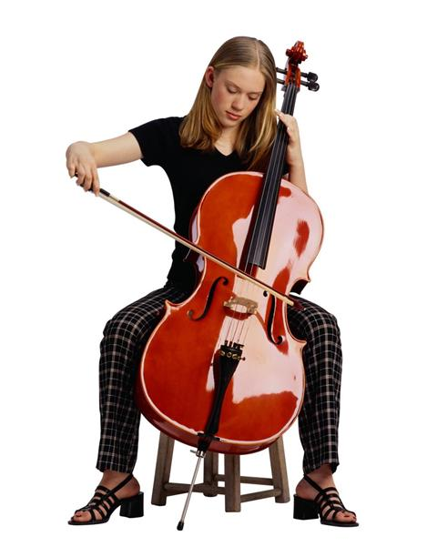
GENDER
Lingering gender bias, often unconscious, may account for some of it.
For example: when auditioning to an orchestra, a female will have 50% higher chances of getting accepted, if the auditions are done in a blind form (which they are now in most major orchestras in the world).

Slide 45
differentiation
It’s not a gifted lecture, if you have not heard this word

Slide 46
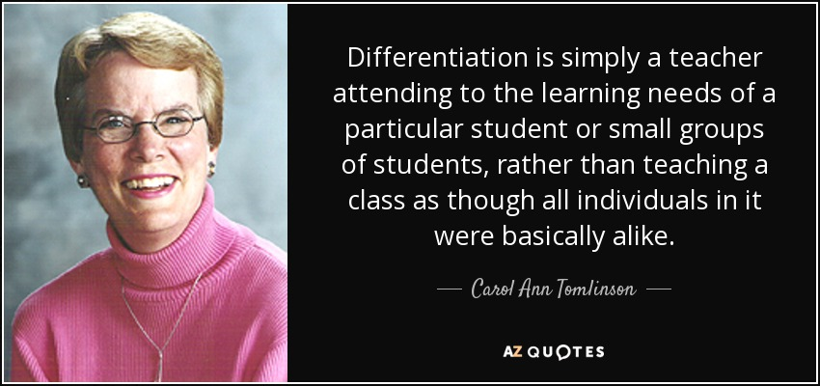

Slide 47
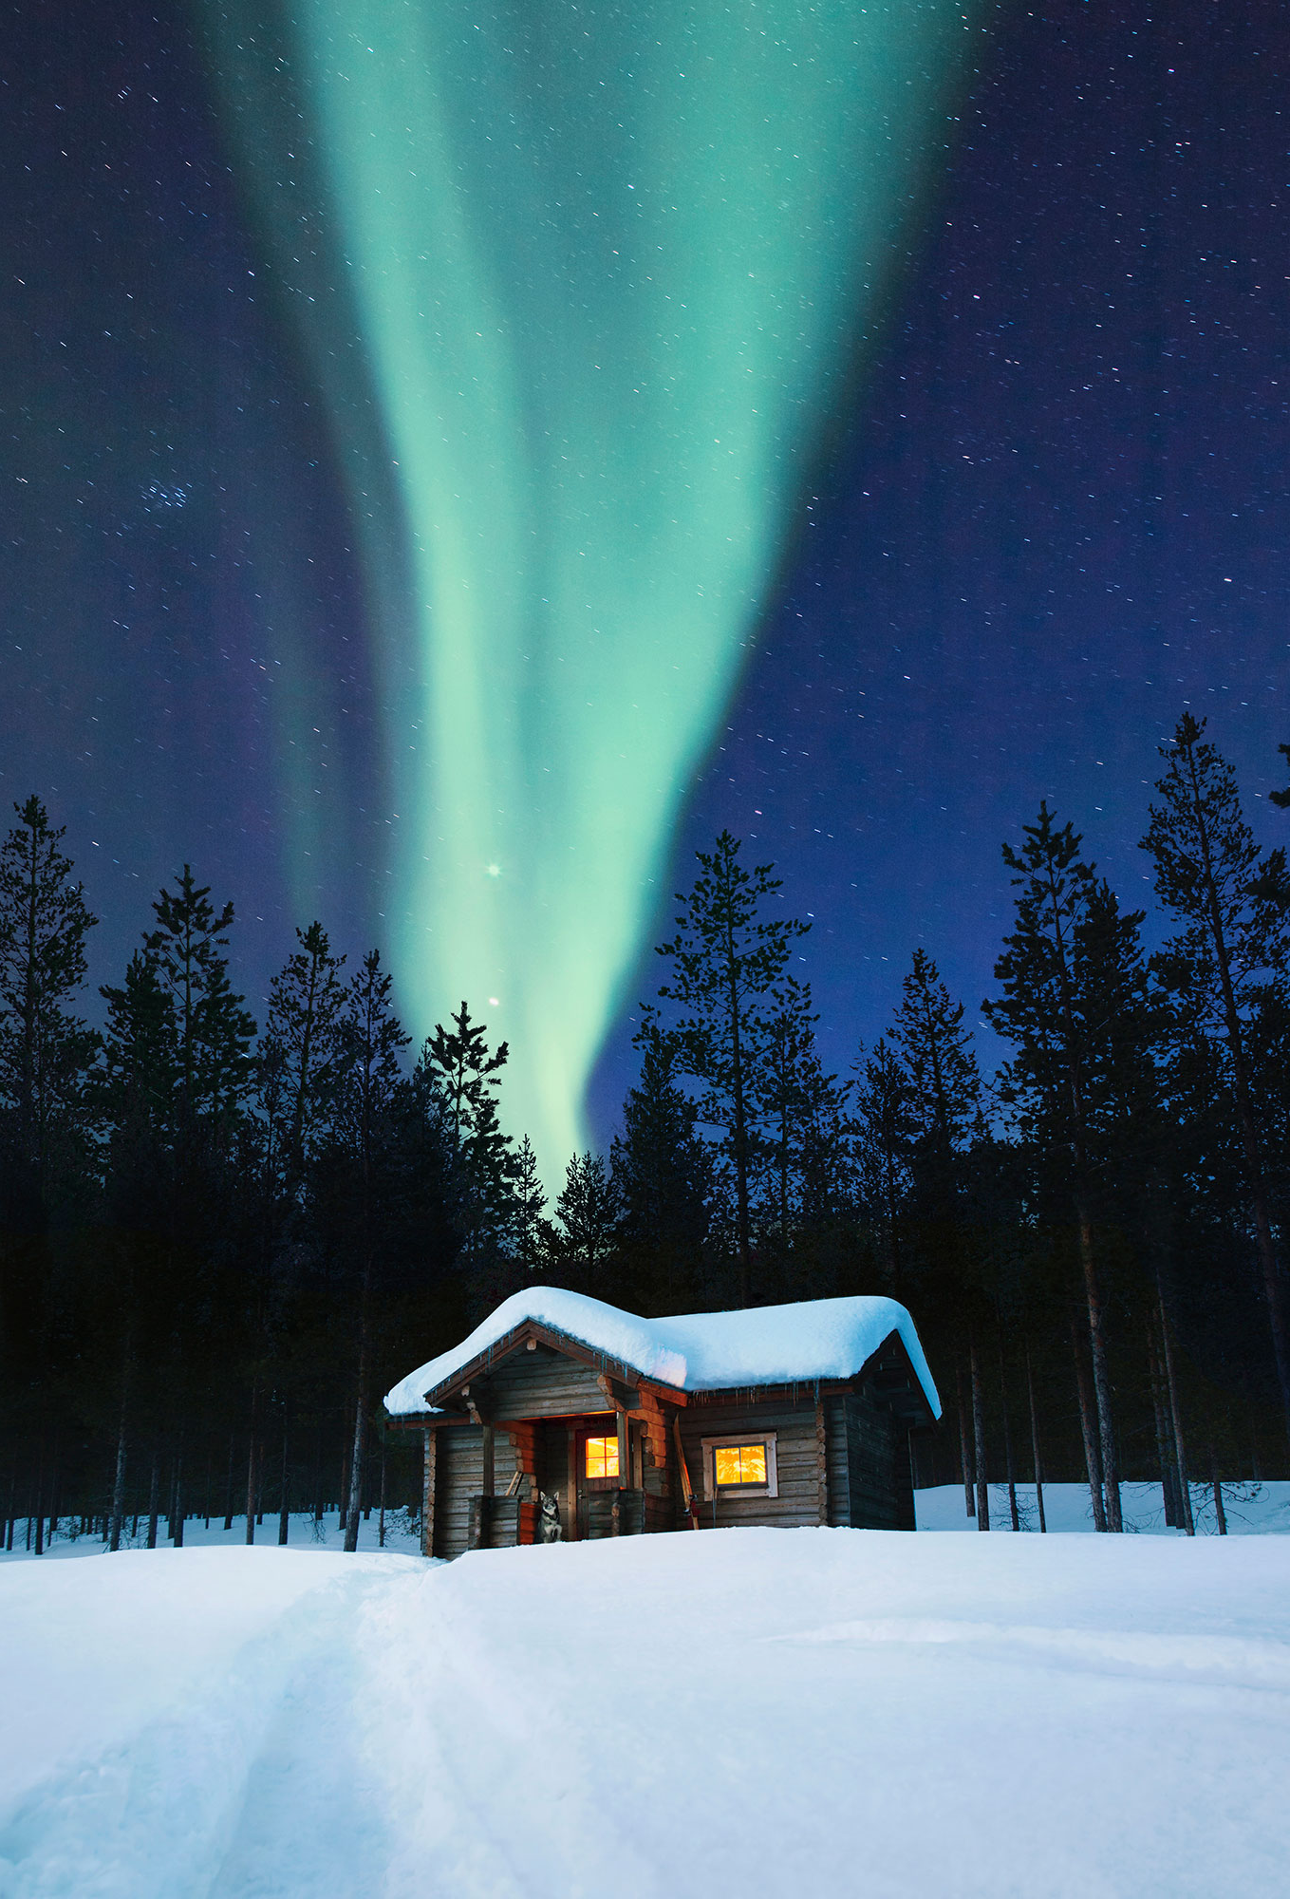
differentiation
Finland – the only country in the world with 0% drop out.
And the highest achieving country in international tests.
And they have the highest pay rate for teachers in the world.
Their main approach is individualized teaching,
art, sports and creativity.

Slide 48

differentiation
In NZ we have a place where we offer personalized teaching, strong support for teachers, involvement of community resources, etc.
This approach is called Alternative Education (?????????)

Slide 49
3 potential differentiation routes
Content
Process
Product
What is being taught
How is it being taught
how students demonstrate their mastery of skills or knowledge

Slide 50
Content
Process
Product

Slide 51
Content
Independent projects (contracted and directed study project)
Process
Cluster grouping, acceleration by grade or subjects, mentoring (with an expert), and minicourse enrichment (University)
Product
Unique and self-directed insights and products ; Motivation ; Eminence

Slide 52
Some concrete examples

Slide 53
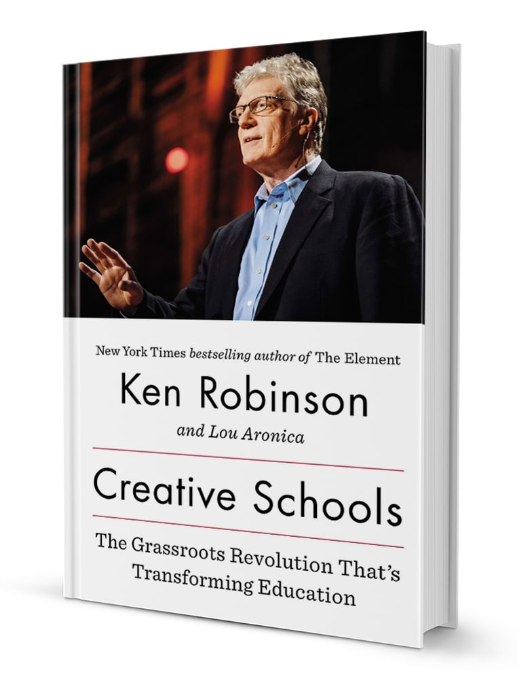

Plenty of books out there…

Slide 54
Samples of classes/topics
These are two examples of lessons and projects which can be implemented during a term:
Wonderworld cluster of lessons and activities
https://vimeo.com/69769455
Junior Books writing activities
https://vimeo.com/69620158

Slide 55
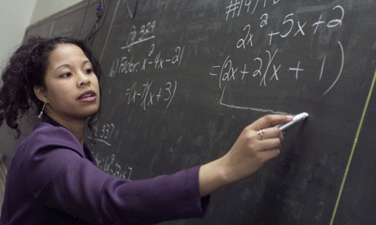
Assessment prior to teaching
Present lesson goals/topics.
Determine the 5 most difficult topics (questions, math problems, etc.)
If a student receives 100% then this student is exempt from rest of practice.
Notes:
Most difficult first

Slide 56
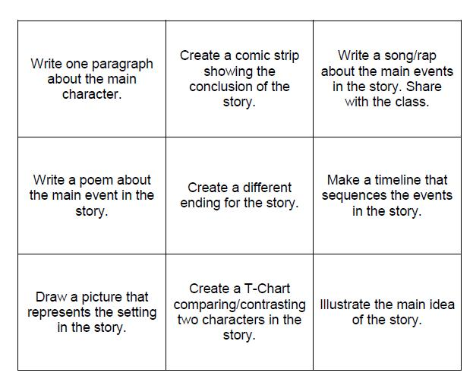
Tic-Tac-Toe
Menu of options for students
Allows for different products and processes

Slide 57
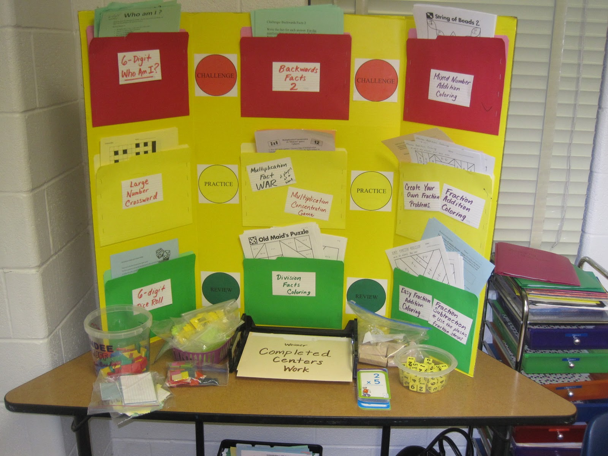
Learning Centers
Located in classroom, media center
Can be portable
Can be used at secondary level as well as elementary

Slide 58
Cool ideas
Laurel Springs School - is a fully accredited private online school for students in kindergarten through twelfth grade, including gifted programmes
https://laurelsprings.com/
Digital Highschool – Stanford University (fully accredited)
https://ohs.stanford.edu/
Northwestern online gifted teaching programme
https://www.ctd.northwestern.edu/program_type/online-programs
Epsilon Camp, a two-week summer program for 8- to 11-year-olds who are profoundly gifted at math: https://epsiloncamp.org/
Many more in here : https://www.kqed.org/mindshift/35786/for-frustrated-gifted-kids-a-world-of-online-opportunities

Slide 59
Extraordinary teachers
Last but not least…

Slide 60
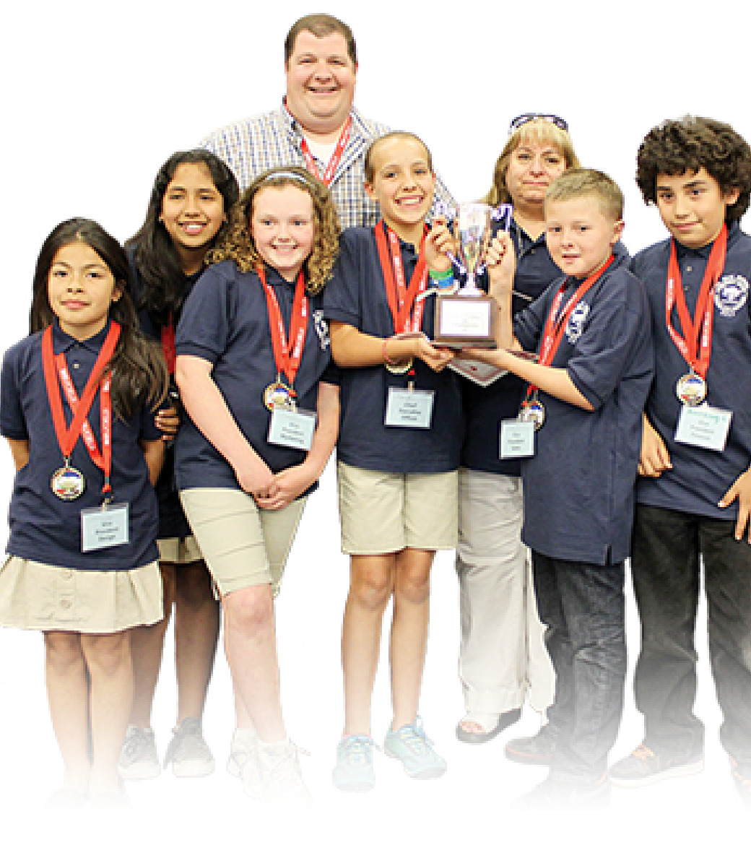
Extraordinary teachers, exceptional students:
the interplay between master teachers and gifted students
Robert. F. Arnove
Phi Delta Kappan. 92.2 (Oct. 2010)

Slide 61

Extraordinary teachers
There is very little development of great research scientists on desert islands.

Slide 62
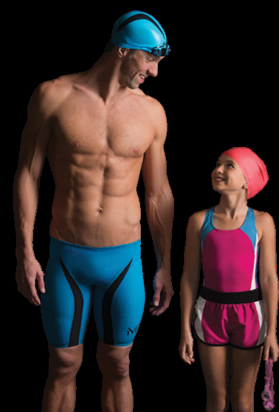
Extraordinary teachers
Michael Phelps is an American retired competitive swimmer and the most successful and most decorated Olympian of all time, with a total of 28 medals.

Slide 63
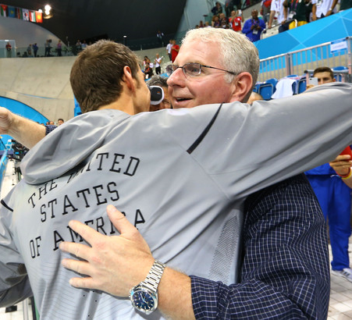
In his interviews, Michael Phelps always seemed to find a way to credit his stellar efforts to Bob Bowman.
His coach
His teacher

Slide 64
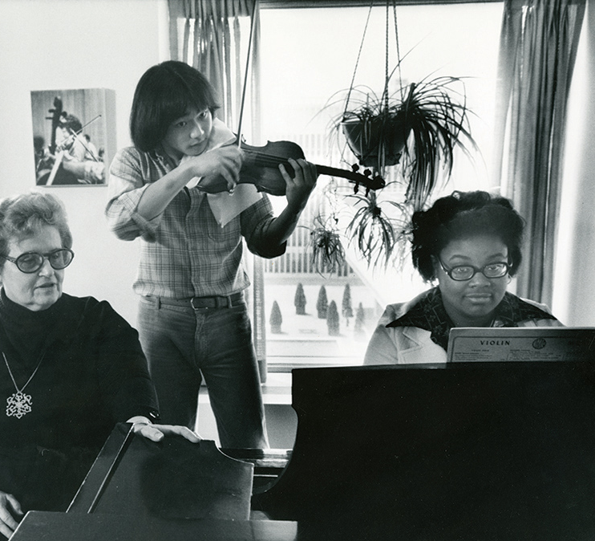
Extraordinary teachers
Dorothy DeLay from the Juilliard School, taught such renowned violinists as Itzhak Perlman, Shlomo Mintz, Cho-Liang Lin, and Midori

Slide 65
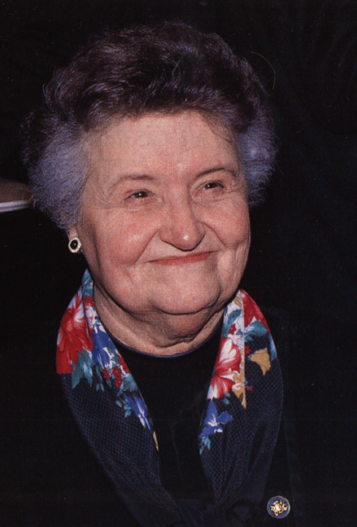
Extraordinary teachers
Said even these former students needed the intervention of a teacher to arrive at their present level of peak performance. "I think everyone needs it. I would not make any exceptions”
And then she described 3 stages to her teaching of children

Slide 66
Dorothy DeLay
Up to about age 12: be someone who supports the family, who helps the parents with their dealings with the child, and who feeds the material to them in a really orderly way
1
As they start to be teenagers, children need a teacher who can really give them good discipline and see to it that everything is really organized
2
As they get older and are ready to go professionally, they need somebody who can lead them toward really beautiful first-class performance and who can help them go into the professional world
3

Slide 67
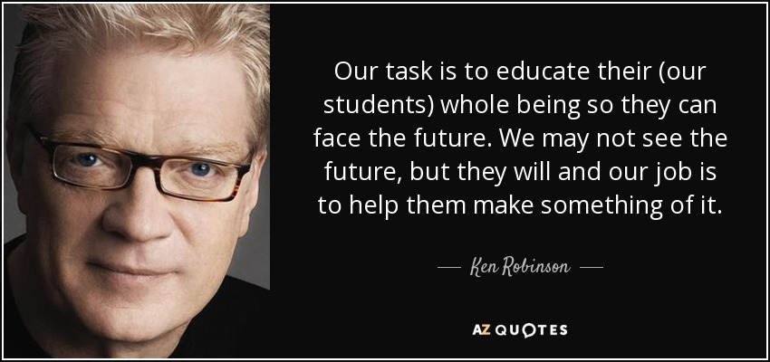

Slide 68




Thank You
Dr Yariv Doron
Child and Adolescent Psychiatrist
Taranaki DHB
New Plymouth
NZ
06-7588687
( ext. 8986)
Yariv.Doron@tdhb.org.nz

